Slide 1
This Workshop
By Nick Del Grosso

Slide 2
Why Did You Decide to Do a PhD?
“I Decided to do a PhD because I…”

Slide 3
What Gives You Motivation at Work?
“I am motivated when...:”

Slide 4
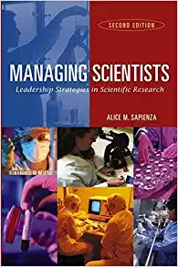
“Being Motivated Implies that you love your job, literally.”

Slide 5
Motivated Groups Have:
Reasonable Working Conditions
  Ensured laboratory safety
  Adequate space
  Available required equipment
Competent People Trained Appropriately for their Job
Assurance of the Link Between Effort and Outcomes
  Must believe that their effort will lead to desired job performance
  Must believe this performance wil lead to certain outcomes
  Mut value those outcomes
Equity and Fairness
  Treated and Paid Fairly, as compared with similar organizations
Appropriate Challenge
  Should not be asked to perform the impossible
  Should be encouraged to go beyond what they initially see as their limits

Slide 6
David McClelland’s 3 Work-Related Needs
Power: A Desire to Have an Impact on People
  titles, activity to influence or inspire, concern with organizational action or success, career position and prestige, strategy
Achievement: A Concern for Doing Things Better
  Numbers, Means-end Statements, winning, doing as well or better than another, concern with how well a task is being performed
Affiliation: A Concern for Establishing Positive Affective Relationships
  Friends, emotions about relationship, helping, positive response from another

Slide 7
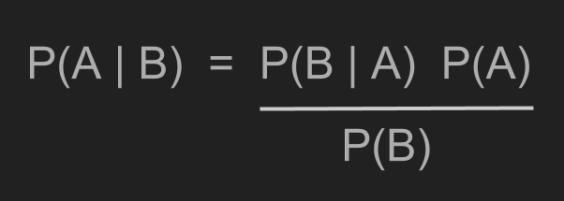
I’d like to discuss Bayes’ Rule today...

Slide 8
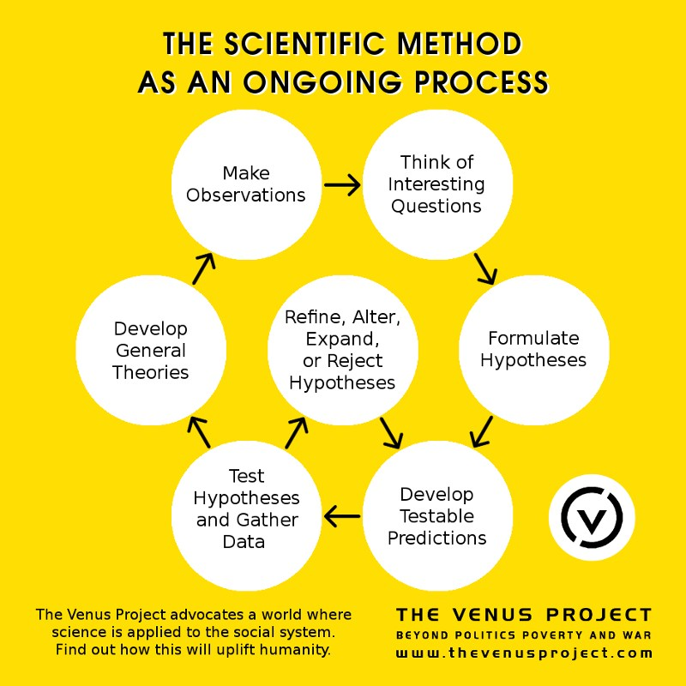
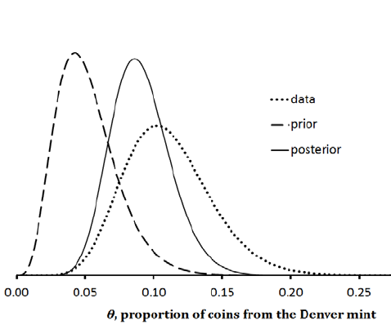
Bayes’ Rule can be applied
iteratively to gain knowledge.
(Mossman et al, 2014)

Slide 9
...But will people use actually Bayes’ if I teach it here? (low impact motivation)

Slide 10
And that reminded me of something I do use, all the time...

Slide 11
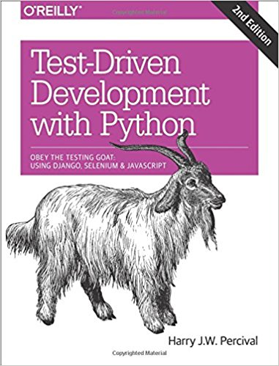
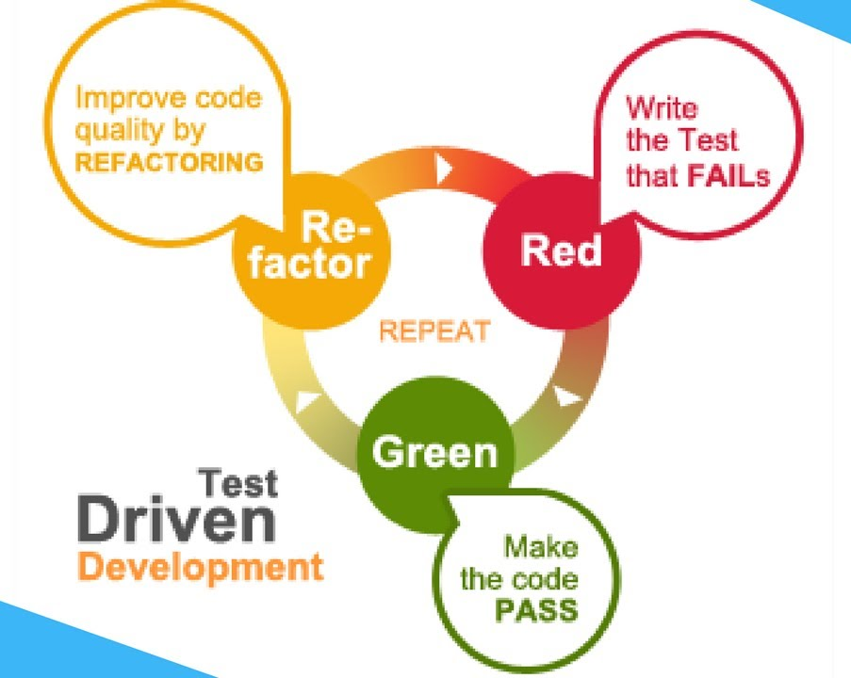
“Tech Primers: What is TDD?” https://i.ytimg.com/vi/T38L7A0xP-c/maxresdefault.jpg

Slide 12
and that reminded me of something...

Slide 13
My Sensorimotor Integration Research:
Trying and Trying to Close the Loop.

Slide 14
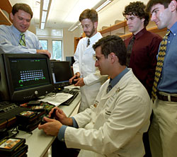
Early
Inspirations
“Teenager moves video icons
just by imagination.”
-Leuthard and Blakely, 2006

Slide 15
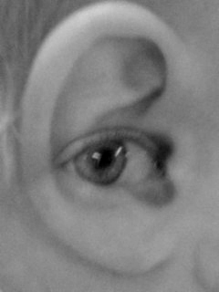
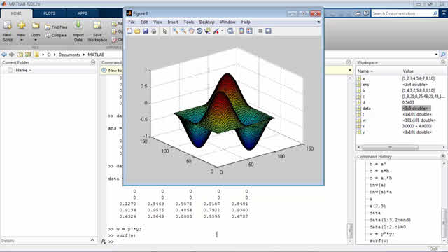

Slide 16
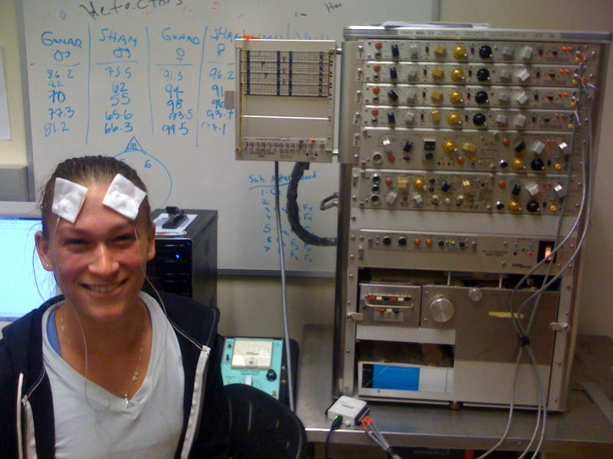
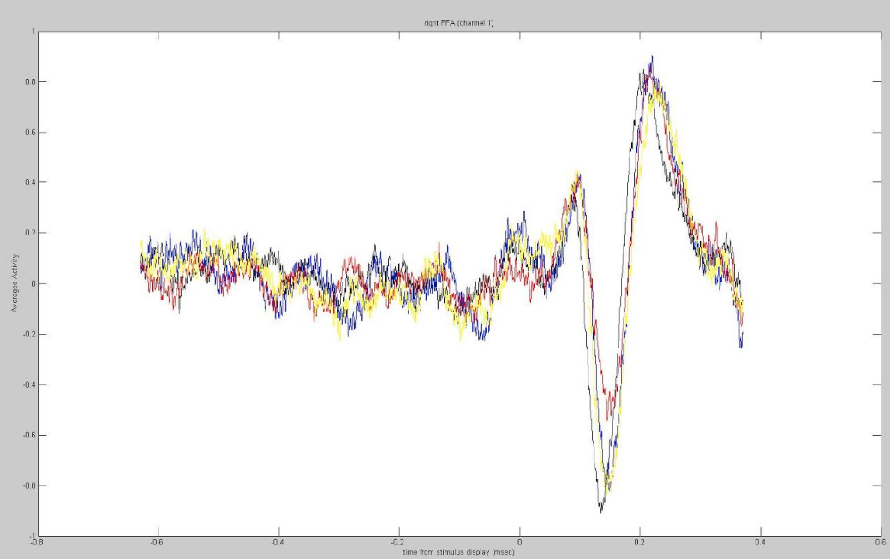
My Bachelor Work: “DIY ERPs: Designing inexpensive EEG systems
for performing auditory and visual cognitive studies.”

Slide 17
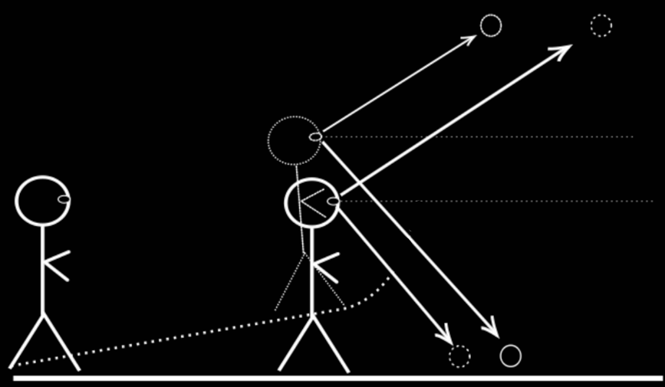
Blind Walking

Slide 18
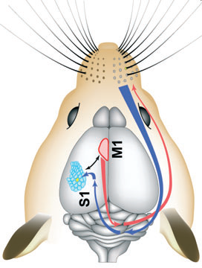
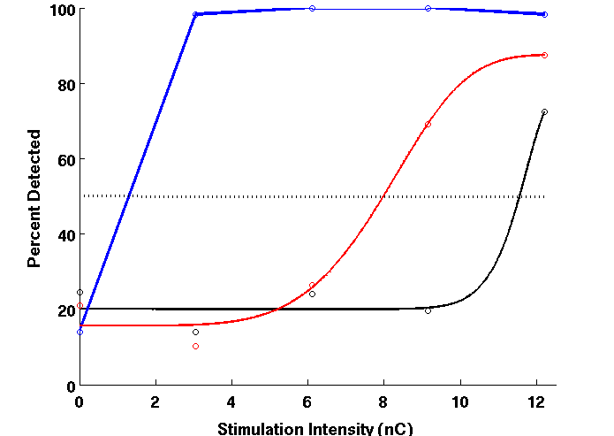
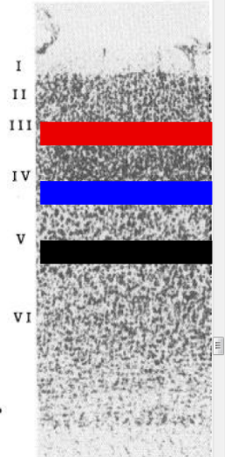
My Lab Rotation: “Layer-Dependent Sensitivity to Electrical Stimulation in Barrel Cortex”
(Aronoff et al, 2010)

Slide 19
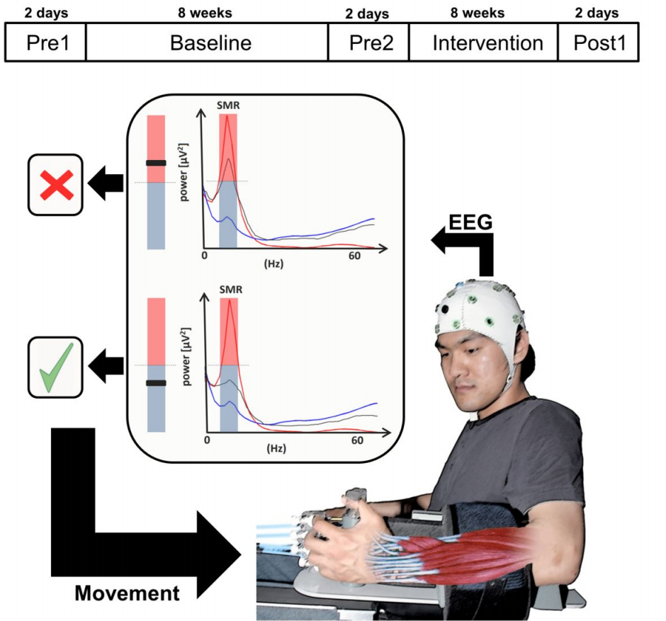
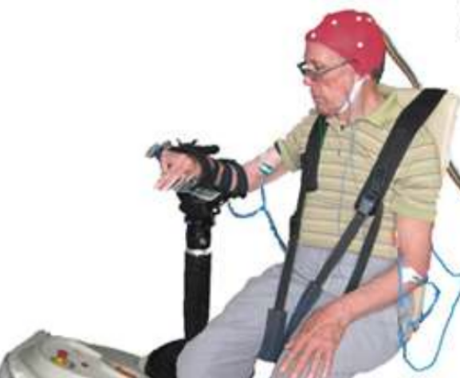
EEG-
Robot
BCI
(Ramos et al, 2014)

Slide 20
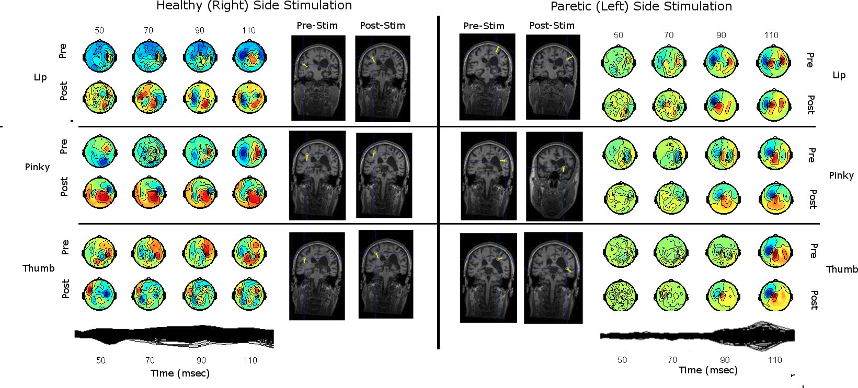
Birbaumer Lab, Dept. of Medical Psychology, Tübingen
My Master’s Thesis: “Neuroplasticity in the Recovering Hemiparetic Stroke Patient”

Slide 21
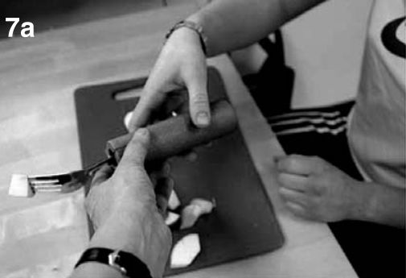
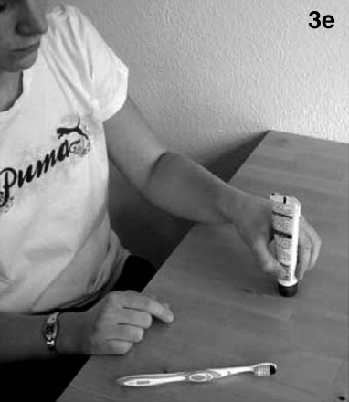
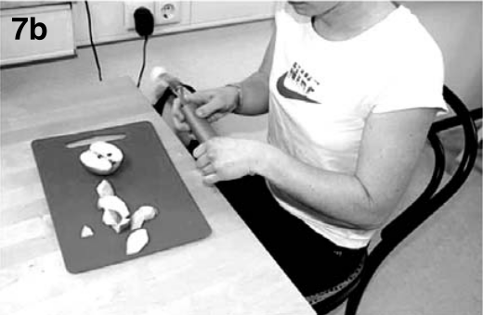
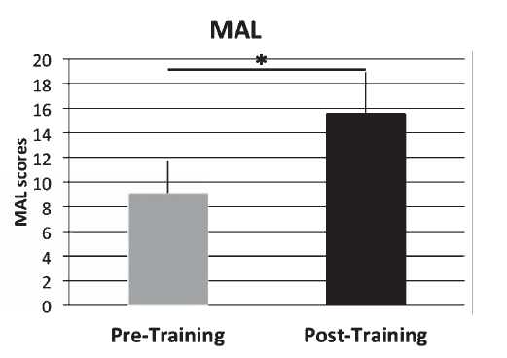
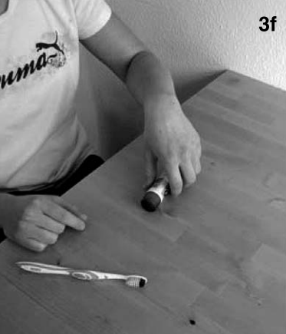
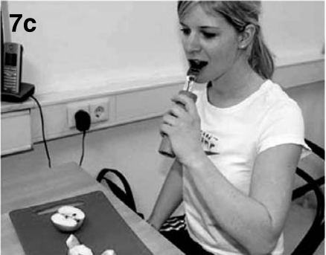
Physiotherapy Enhancement through Rich Experiences
(Broetz et al, 2014)

Slide 22
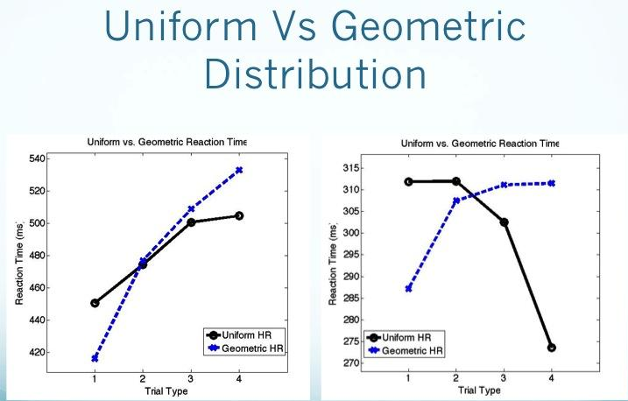
Attention and Hazard Rate

Slide 23
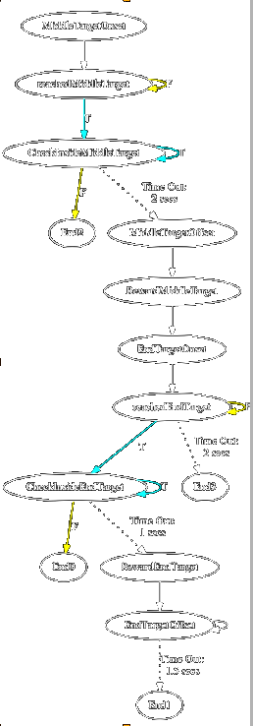
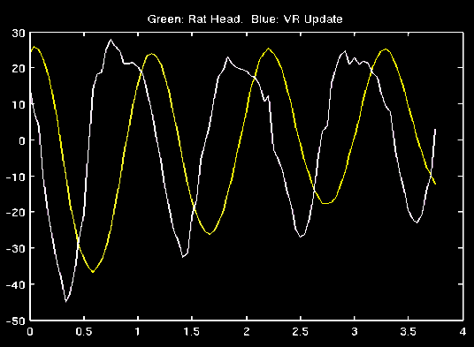
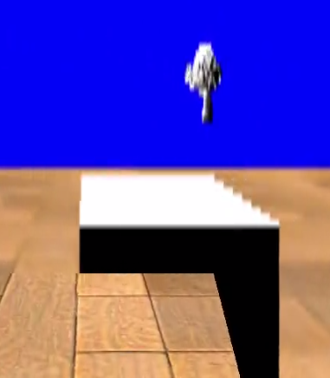
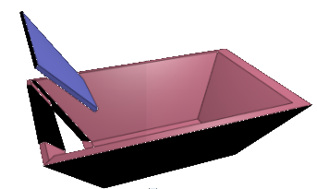
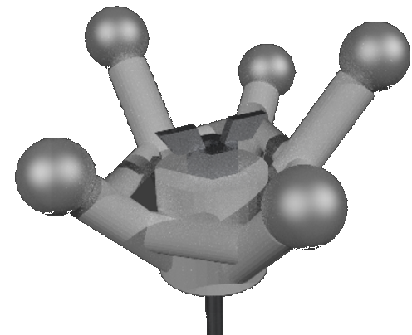
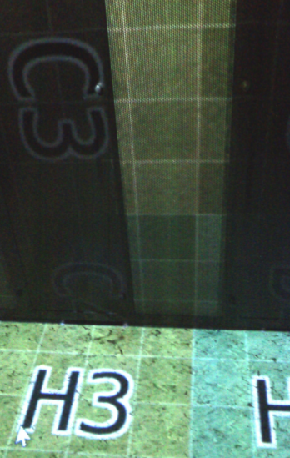
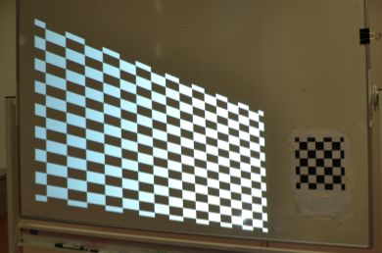

2013-2014: HippoVR
Input Lag: 120 msecs

Slide 24
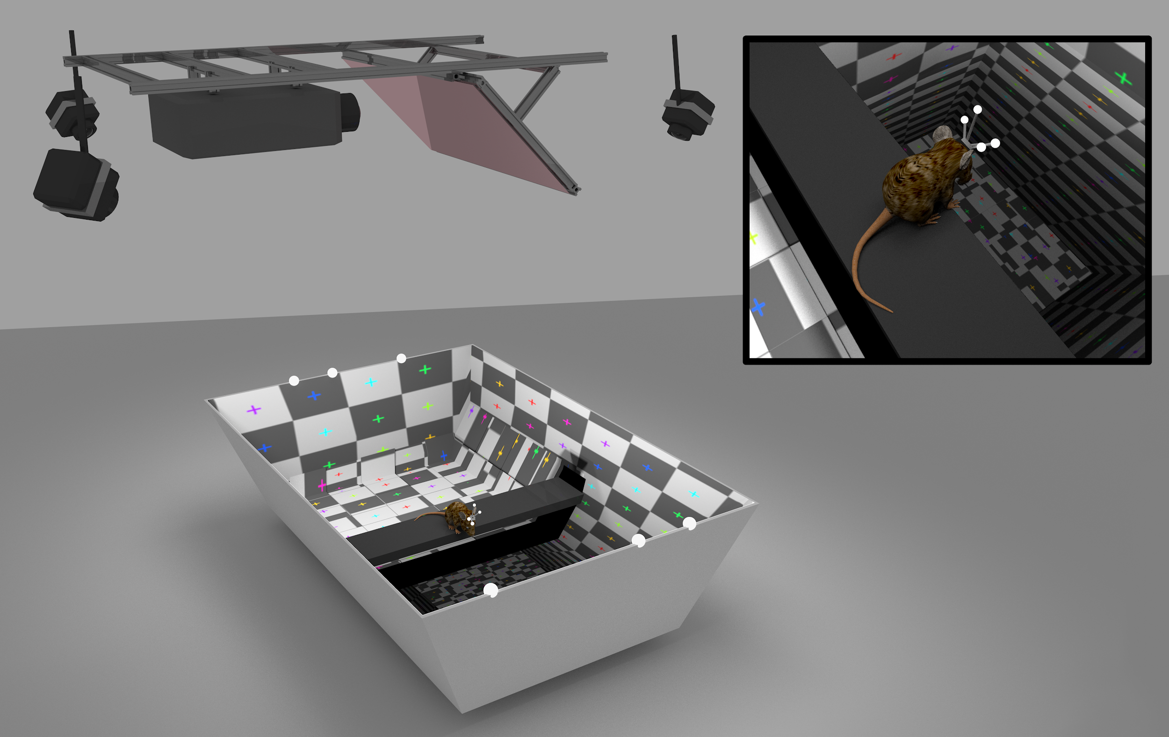
2016: The ratCAVE VR Setup

Slide 25
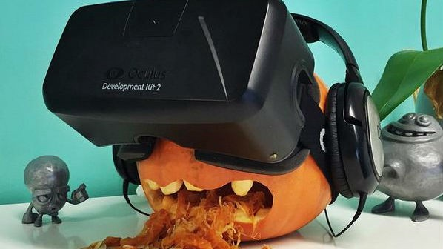
2018:Preventing VR Sickness

Slide 26

In Summary:
I am very interested in the importance of closed loops in sensorimotor research.
I have also not published much.

Slide 27
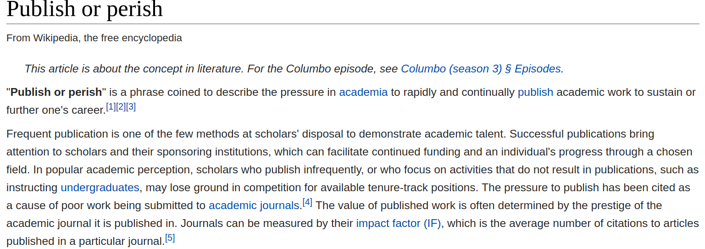

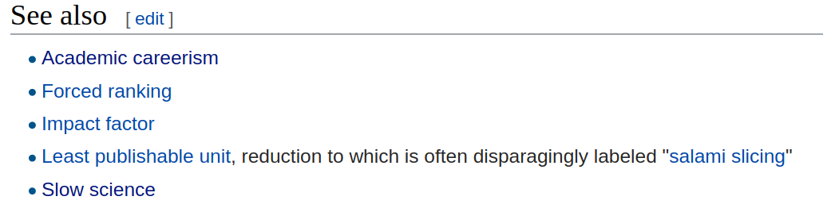

Slide 28
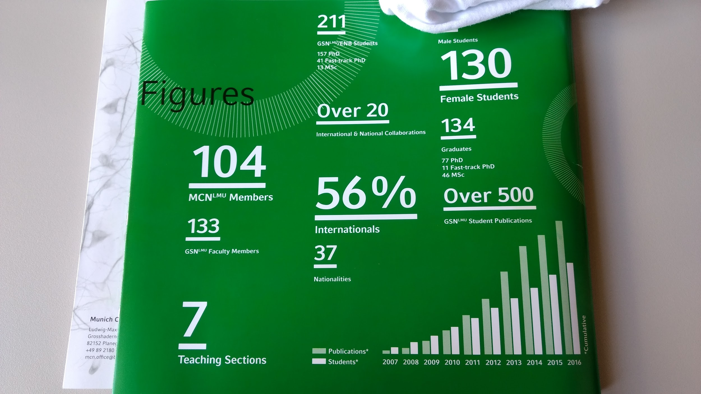

Slide 30
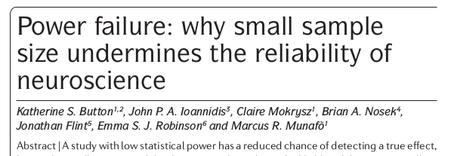

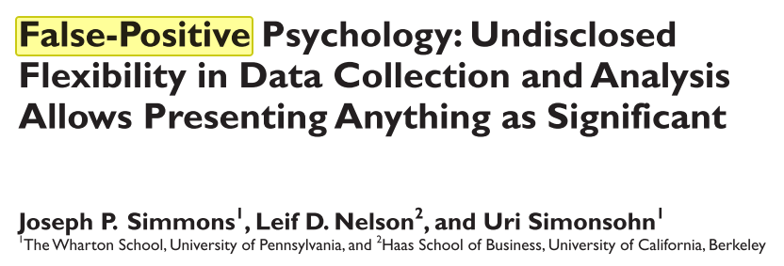
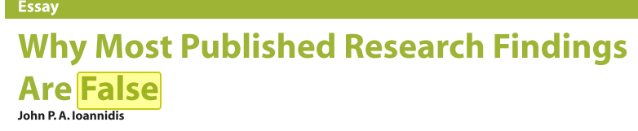

Slide 31
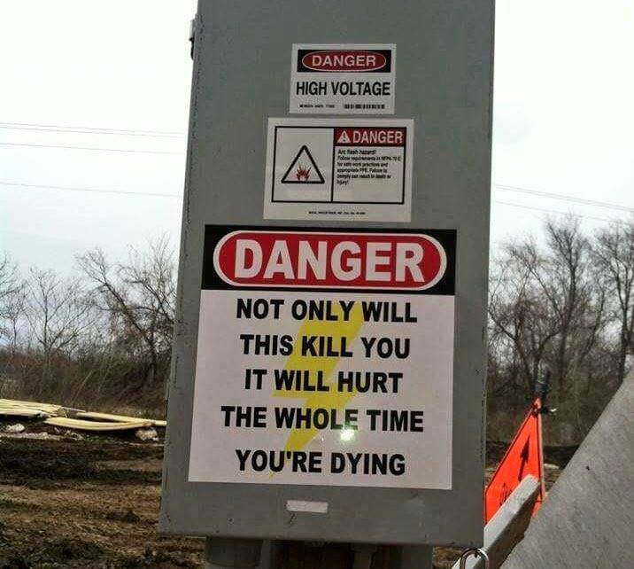
I Think This Isn’t News to Most of Us

Slide 32
Burnout:
What happens when your work-related needs aren’t met for a long time.
“Burnout is a psychological syndrome of
emotional exhaustion
reduced personal accomplishment
  may feel unhappy with oneself
  feel dissatisfied with accomplishments on the job
depersonalization
  negative, cynical attitudes and feelings
  dehumanized perception of others
(Maslach et al, 1996)

Slide 33
Discussion
What proportion of time in a representative week do you spend doing things that match your listed work motivations?
Do you feel effective, competent, creative, and valued?
How likely is it that someone in your group will experience burnout during their PhD?
What percent of people in your department do you think are currently burned out?
Is this having an impact on your research?

Slide 34


Slide 35
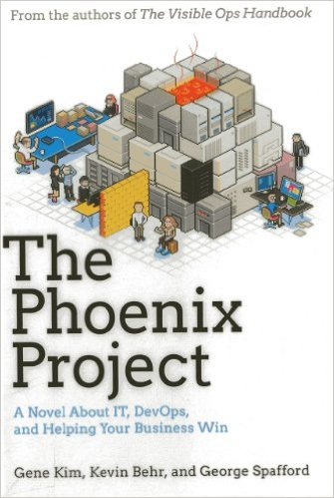


Slide 36
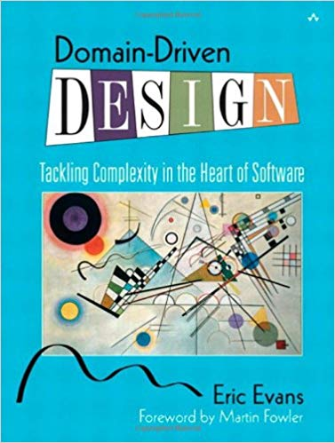

Preparation: Book Reading

Slide 37
...and that’s how I came up with this workshop:

Slide 38
Productivity in Science
Probability Theory, Test-Driven Development, and
Lean Management Principles, presented by Nick Del Grosso

Slide 39
My Goals for this Workshop
To test my understanding of the material I read on management.
To convince scientists that their work can be sped up while at the same time:
  Improving Quality
  Increasing Innovation
  Decreasing Stress
To persuade you to look to industry for inspiration on organizing and managing academic research work.
To introduce you to some concepts underlying Lean Management.
To test my ideas on others and find faults in my logic, so I can refine my mental models on how research should be effectively done.
To get feedback on my quality of teaching.

Slide 40

Proposal: Let’s Embrace “Publish or Perish”
Research Outputs
Knowledge
  Theoretical Models
  Important Insights
  Experimental Methods
  Intellectual Property (e.g. Patents)
Data
  Experimental Data
  Simulation Data
...and combinations of Both.
The Chronicle of higher Education: Schaberg, 2016

Slide 41
Motivation:
To be accomplished researchers doing impactful research in an engaging, innovative, and positive research community.

Slide 42
Goal: To Regularly Publish High-Impact, High-Quality Research

Slide 43
“Lean Research” = Lean Development + Lean Operations
Lean Product Development
  Produces Knowledge
  Produces Operational Value Streams
Lean Manufacturing Operations
  Produces Products

Slide 44
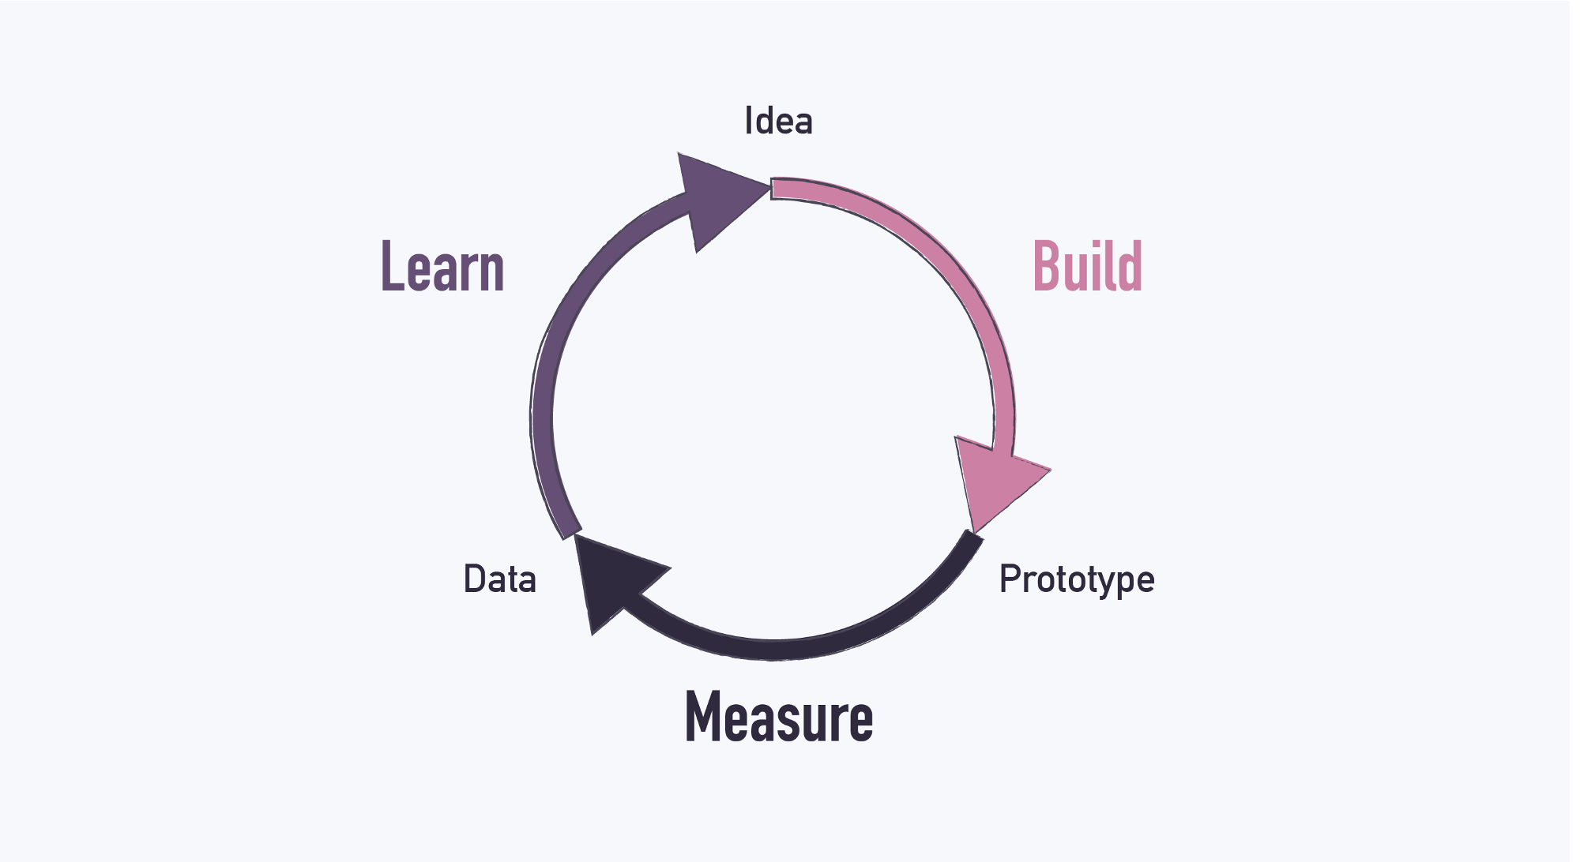
https://cdn-images-1.medium.com/max/2000/1*bQNUb7g69o9lHWfE5qCW4A.png

Slide 45
Lean Methodologies focus on Increasing Productivity by Minimizing Waste

Slide 46
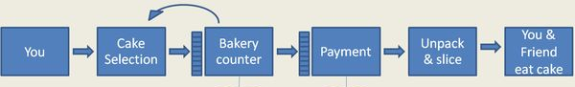
p(Success): What is your Project Risk?
Independent Probabilities can be multiplied.
  p(My Animals Surviving Surgery) = 0.9
  p(My Animals Learning the Task) = 0.8
  p(Both) = 0.9 * 0.8 = 0.72
Task: estimate the total risk of each of your projects.
http://www.johngoodpasture.com/2015/11/value-stream-mapping.html

Slide 47
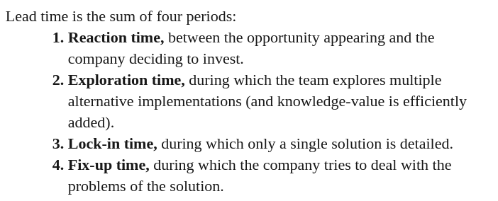
Lead Time: Can You tolerate this risk?

Slide 48
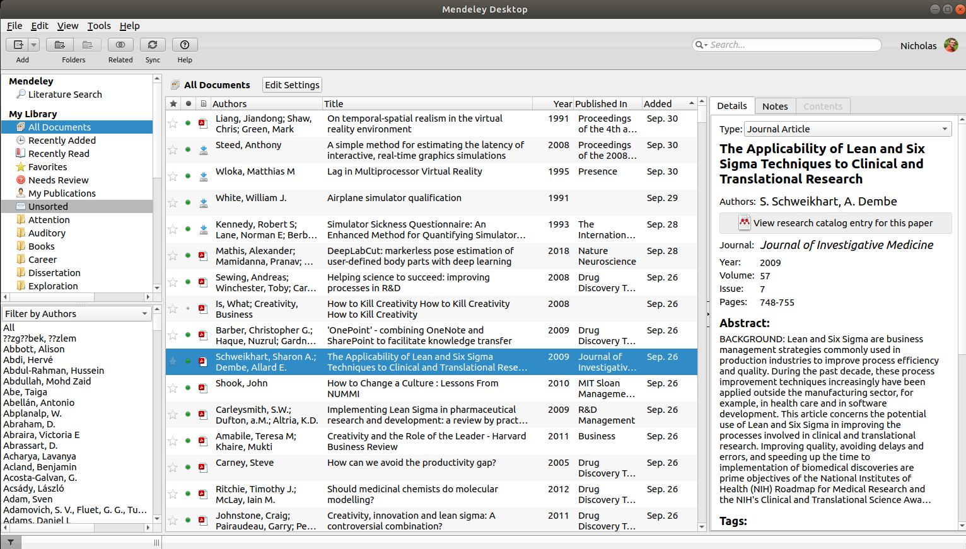
Literature Reviews Make a Big Difference

Slide 49
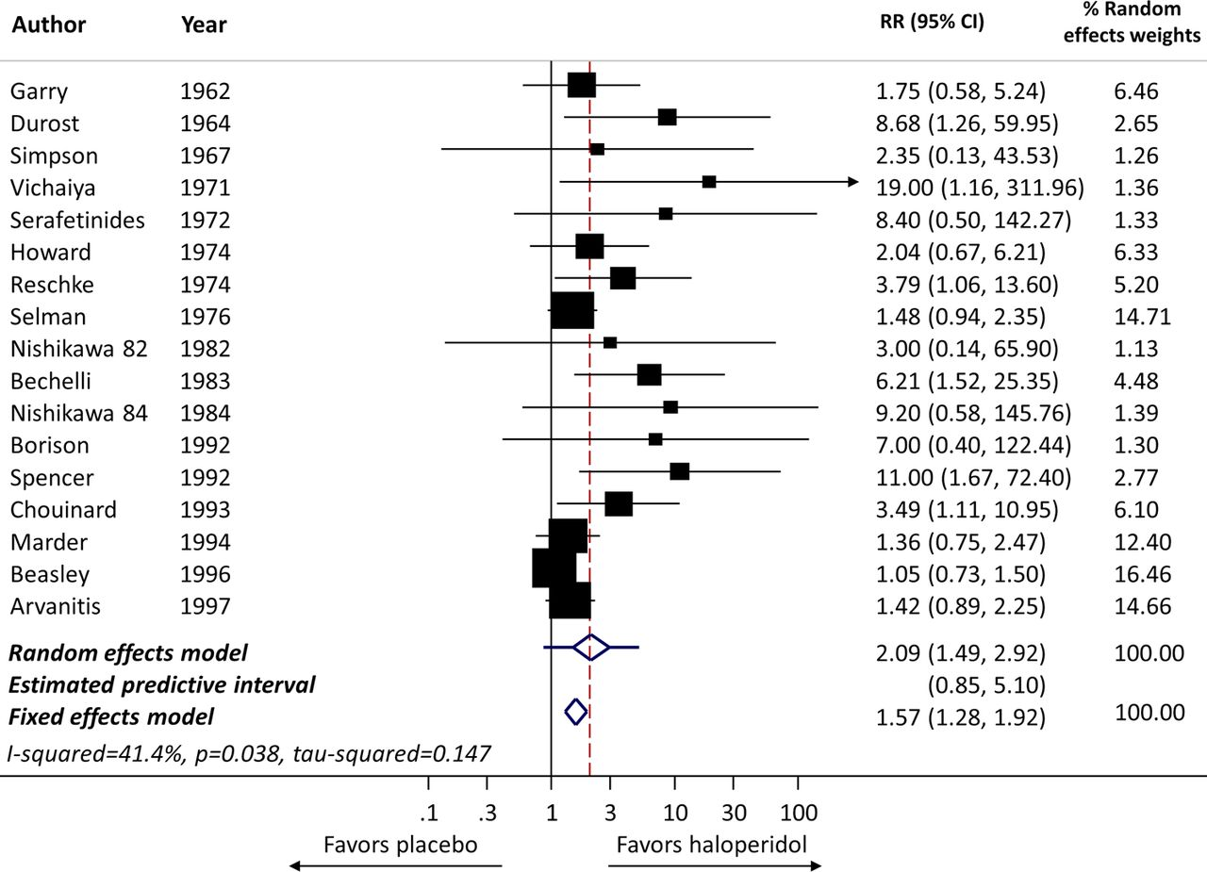
Apply Knowledge from Literature with Meta Analysis
(Chaimani et al, 2014)

Slide 50
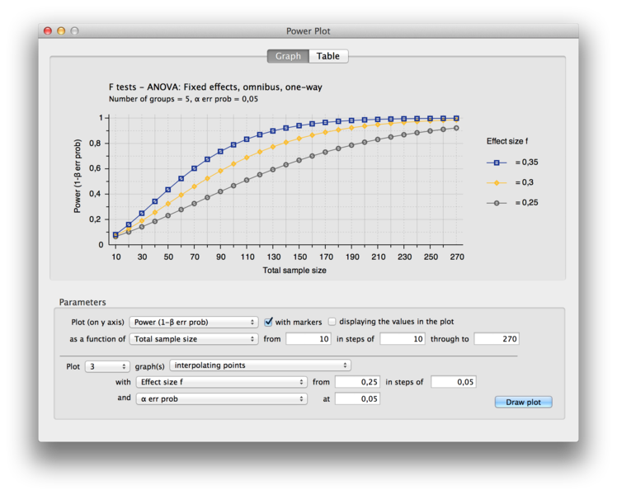
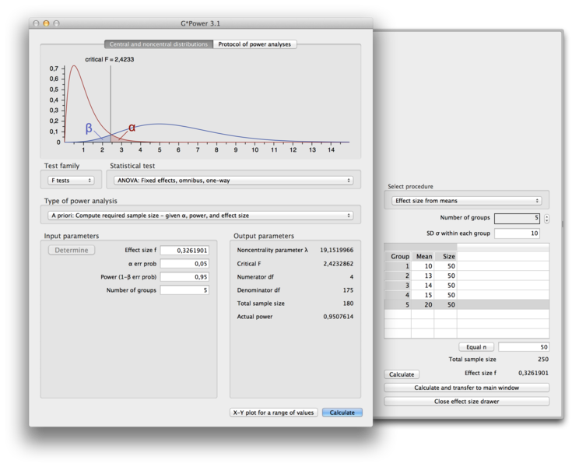
Estimate Needed Sample Size with Power Analyses

Slide 51

Present Your Plans Early and Aggressively Search for Failure Points

Slide 52
Insights from Learning-Centered Teaching: Knowledge Distribution Must be Goal-Focused
Journal Clubs:
  Training of Critical Thinking and Reading Skills
Progress Reports:
  Identification of failure points and deviation estimation from target product
Conferences / Talks:
  Impact scientists by changing their behavior (use your methods, cite your work, work in your field, hire you for positions, give you resources)

Slide 53

Preregister

Slide 54

But Stay Efficient: Beware of Knowledge Waste

Slide 55

Lean Management is Sometimes Unintuitive,
Often Unconventional

Slide 56

Strategy: Find the Root Cause

Slide 57
Solutions for Minimizing Scatter
(quoted from book)
Stop Reorganizing
Reduce demands for information on short notice from subordinates.
Respond to “fires” with the least disruptive but effective response. If it is someone’s job to put out the fire, let them do it.
Stop sending out or replying to excessive email or voice mail.
Think twice about adding more projects.
Stop adding formatl structure (tasks, checks, reports) to your development process.

Slide 58

Minimizing Knowledge Waste from HandOffs
One Person owns the Outcome.

Slide 59
Eventually, you’ll come to a consensus on a solution...
Bayes Demo Time!

Slide 60
Upon Consensus, Produce!
Produce either Knowledge or a Product

Slide 61
End of Part 1.
Break!

Slide 62
Beginning of Part 2.
Unbreak!

Slide 63
Lean Experiments:
Lessons from Toyota and DevOps

Slide 64
Value-Stream Mapping: Visualizing Lead Time
Exercise: Make an experiment value stream map, using an example from your laboratory or department.
http://www.johngoodpasture.com/2015/11/value-stream-mapping.html

Slide 65
Lean Operations Minimize Waste
Brainstorming Exercise: Identify as many sources of wasted time in this value stream map as possible.
Feel free to adjust the value stream map if you see places to add more detail.

Slide 66
Lean Operations Minimize Waste
Waste of Overproduction: creating things that don’t add value
Waste of Time on Hand / Waiting
Waste of Transportation
Waste of Processing Itself
Waste of Stock at Hand
Waste of Movement
Waste of Making Defective Products
Waste of Underutilized Workers
Notes:
Waste of overproduction (largest waste): creating things that don’t add value (aren’t demanded by customer)
software features no one is using
experiments that don’t answer your research question
collected data that’s never analyzed
apparatus no one uses
“Scooped” projects
Waste of time on hand (waiting)
Waiting for reviewers for a paper
Waiting for licenses, ordered materials, workshop, approvals
waiting for animals to be ready for the study (habituation, handling, training, recovery, etc)
subject recruitment delays
waiting for feedback
waiting for apparatus to be available
waiting for collaborators to complete their work
Waste of transportation
moving animals from animal facility
Waste of processing itself
?
Waste of stock at hand
Low yield rates for chemicals?
Lost animals to death, bad implantation, etc
Waste of movement
Manual running of automated process.
Time spent searching, installing software, etc
walking back and forth between rooms for commonly-related tasks
long search times for often-needed tools and parts
Waste of making defective products
Non-replicated studies
Re-done experiments due to too-small sample sizes or missing controls
Waste of underutilized workers
People searching for answers when knowledgable coworker is nearby
Poor match between scientist and task
Little use of background training.

Slide 67
Lean Operations Minimize Waste
Brainstorming Exercise: Identify as many sources of wasted time in this value stream map as possible.
Feel free to adjust the value stream map if you see places to add more detail.

Slide 68
“The First Way”
Create a Constant Feed-Forward Flow
Waste is Often Spent Waiting.
  High “Work in Progress”
  Ignoring this aspect creates a Push System
  Wastes Effort, Decreases Responsiveness of System

Slide 69
“The First Way”
Create a Constant Feed-Forward Flow
  Exercise: Pushing and Pulling Paper Airplanes

Slide 70

“The First Way”
Create a Constant Feed-Forward Flow
  Toyota’s Solutions
    “Andel Cords/Buttons”
    “Swarming” Problems
    Slack Time
    Decrease Batch Size
    Kanban Boards
  Discussion: How can we apply this to our research?

Slide 71

KanBans: Keeping Your Value Stream Visible

Slide 72

Trello.com Example: PyData Munich Org Team

Slide 73

Note: Flow in Psychology seems somehow related to me
Flow theory (psychology) postulates three conditions that have to be met to achieve a flow state:
One must be involved in an activity with a clear set of goals and progress. This adds direction and structure to the task.^{[14]}
The task at hand must have clear and immediate feedback. This helps the person negotiate any changing demands and allows them to adjust their performance to maintain the flow state.^{[14]}
One must have a good balance between the perceived challenges of the task at hand and their own perceived skills. One must have confidence in one's ability to complete the task at hand.^{[14]}
(wikipedia entry on Flow)

Slide 74
“The Second Way”
Maximize Flow with Feedback Systems
Work that moves backwards:
  Creates Unplanned Work.
  Indicates unknown root problems
  Increases Bottlenecks

Slide 75
“The Second Way”
Maximize Flow with Feedback Systems
  Toyota’s Solutions:
    Visual Indicators of Quality at all Work Stations
    Single-Piece Flow
  Devops Solution:
    Test-Driven Development
    Version Control Systems
    Minimally-Viable Product
    Continuous Deployment
  Discussion: How can we apply this to our research?

Slide 76
Demo:
Test-Driven
Development
“Tech Primers: What is TDD?” https://i.ytimg.com/vi/T38L7A0xP-c/maxresdefault.jpg

Slide 77
The Third Way: Cultivate a Culture of Experimentation and Innovation.

Slide 78
Conclusions
We are motivated to be good researchers.
Productive research creates research products.
Finding innovative approaches requires thinking like a product developer.
Committing to an experiment requires thinking like a manufacturer.
Reducing waste is essential to being lean.
Slack time is essential for productivity.
Pull-feedback systems create smoother flow and higher quality.

Slide 79
My (Limited) Experiences
Since adopting these mindsets and strategies:
My work has improved
My students are more motivated and creative
I’ve written two more manuscripts
I decided to stay in academia.
I fell in love with research again!

Slide 80

Further Study: There is more to learn from industry
(“The Difference Between Design Thinking, Lean Startup, and Agile”, Glaveski 2017)

Slide 81
Evaluation and Feedback:
Your Position (e.g. Master, PhD, Postdoc, PI)
How Much Did you Enjoy this Workshop? (1-10)
How Valuable is this Topic for You? (1-10)
How Engaged Were You? (1-10)
What things did you like about the workshop? (3-5 items)
What would you like to see Improved in a future workshop on this topic? (3-5 items)

Slide 82
Thank you for your attention!

